Slide 1
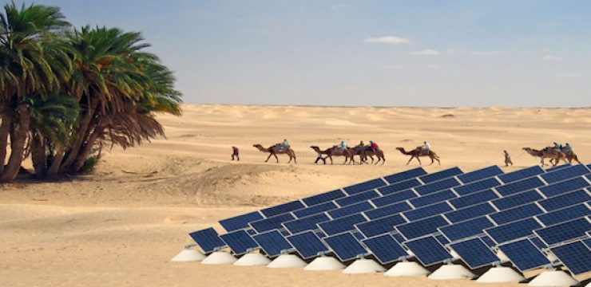
SolarPesa
Project Presentation

Slide 2
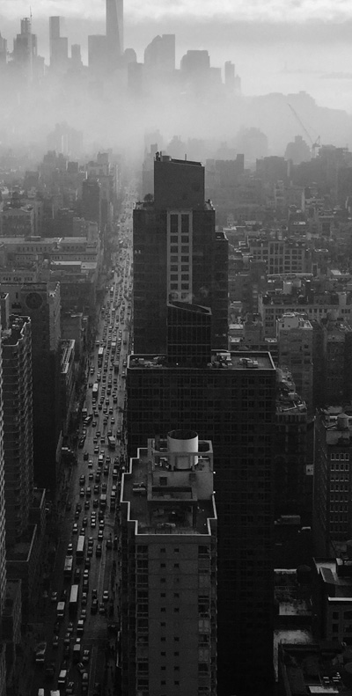
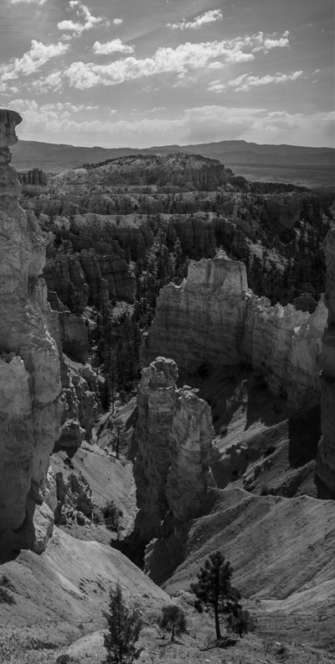
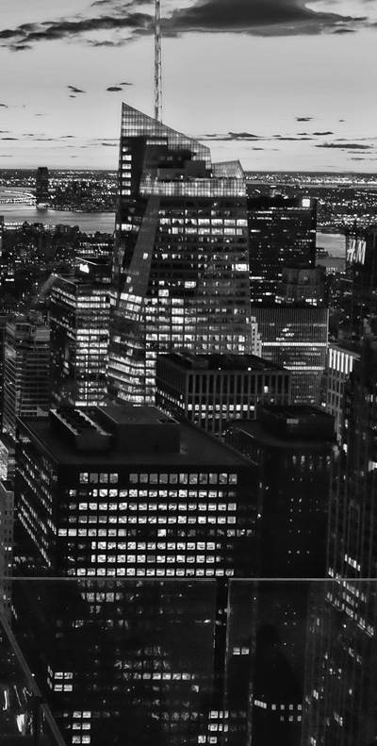
Question to
Government
Will people buy Solar Panels if there is no government subsidy?
How many of us use solar panels at home?
Will all the tax payer’s money will go into installation of solar panels not into other sectors, as by 2020 our requirement for solar would be double as of today?

Slide 3
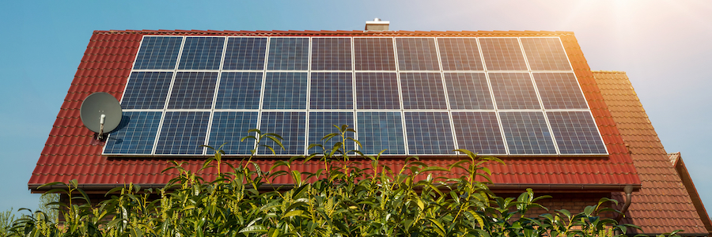
Our Problem Statement
Lack of sustainable method to promote solar and other renewable energy resources.

Slide 4
SolarPesa
An IOT based system where govt. can promote solar as an investment.
Returns before has been relative but it is monetary now.
Features:
Android app to invest and collect ROI
Arduino based solar energy generation monitoring on app
Arduino based consumption monitoring on app
Solar bill payment

Slide 5
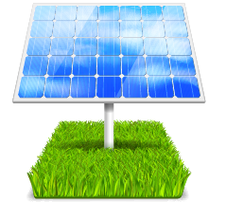
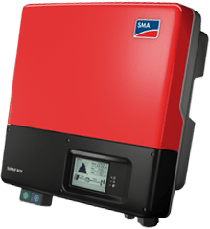
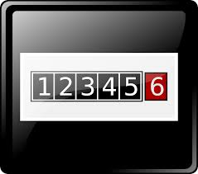
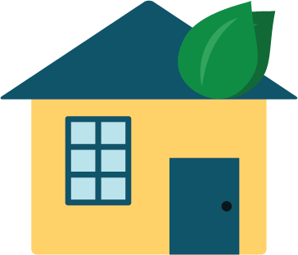
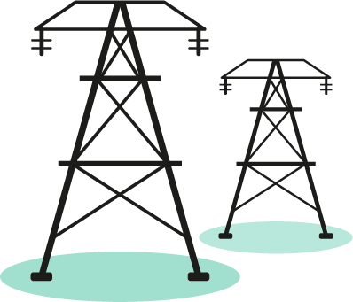
Proposed System
The proposed system can be integrated in current subsidy scheme and roof top scheme of Rajasthan Government.

Slide 6
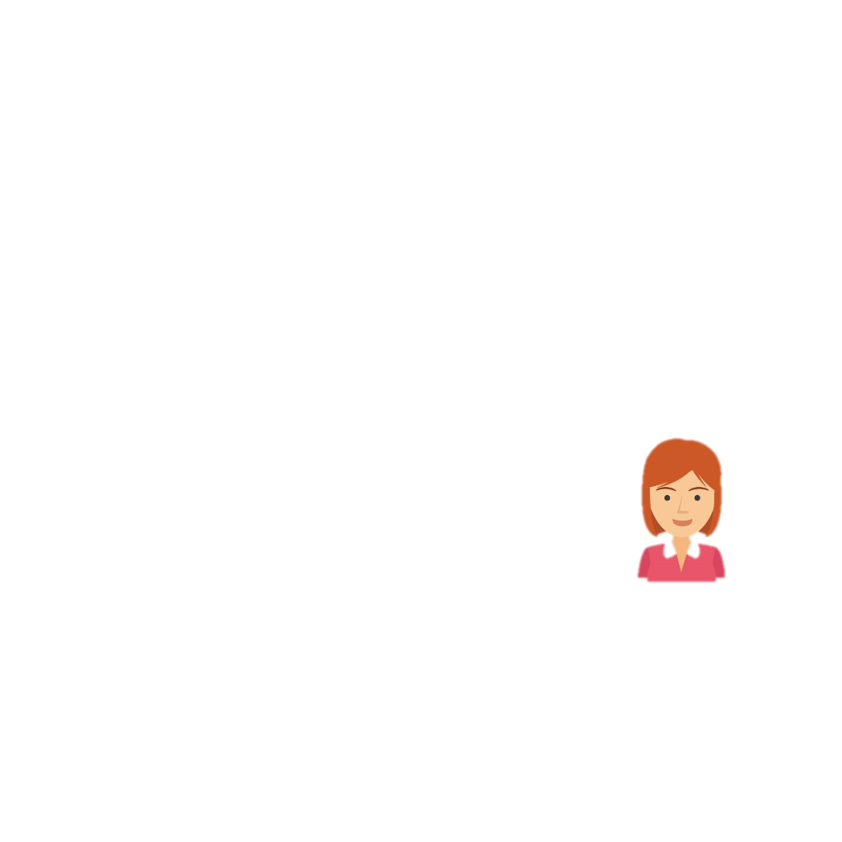

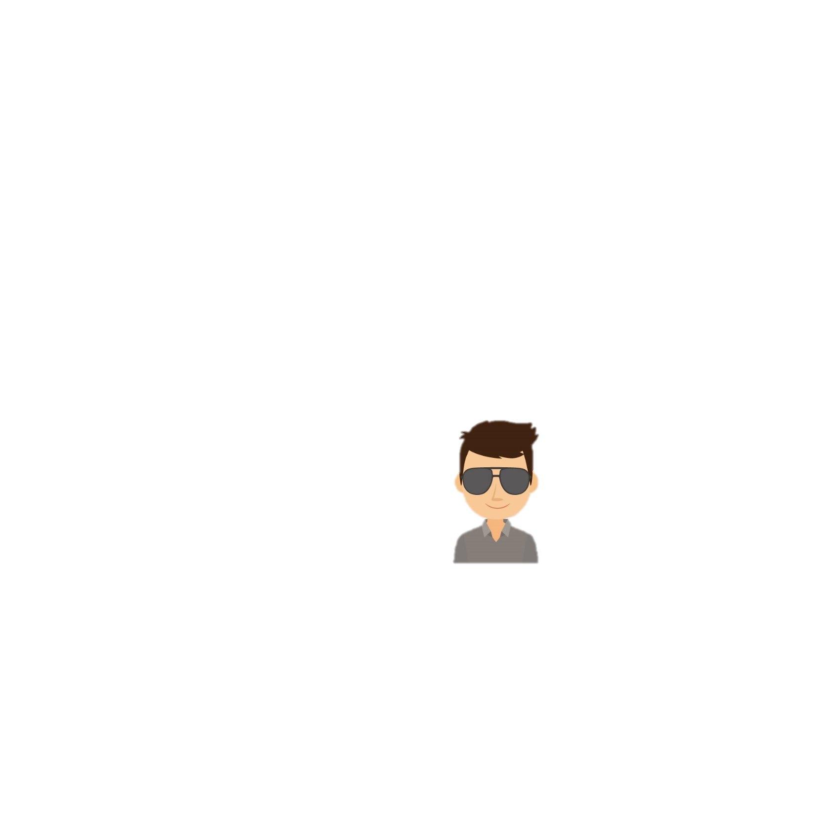

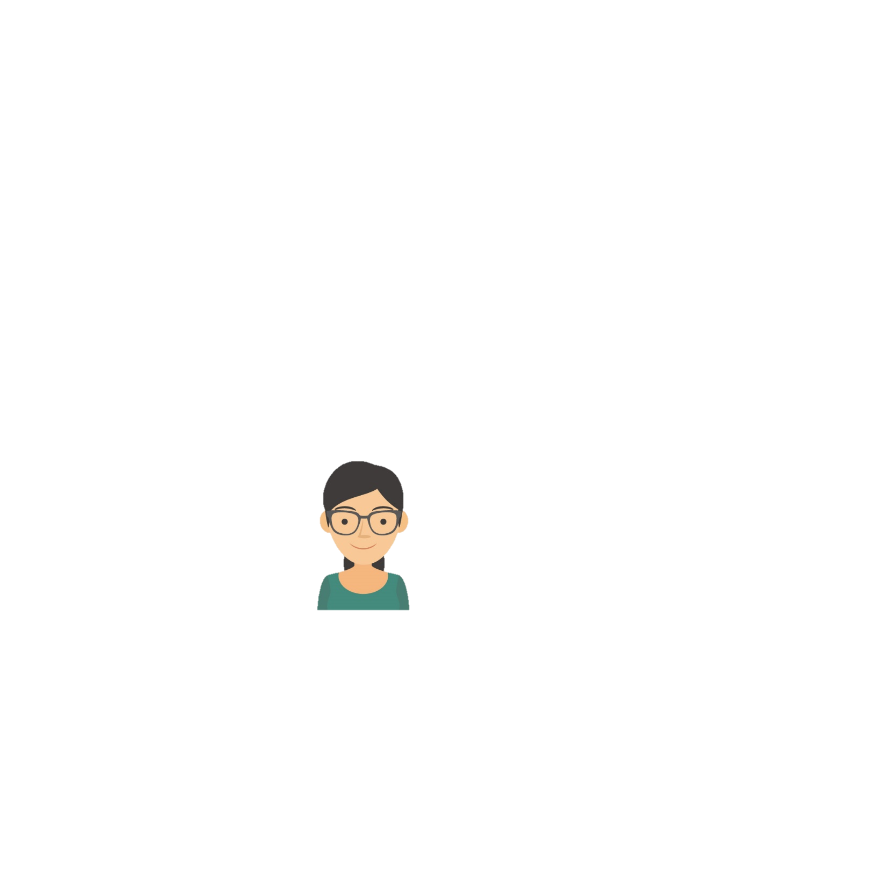

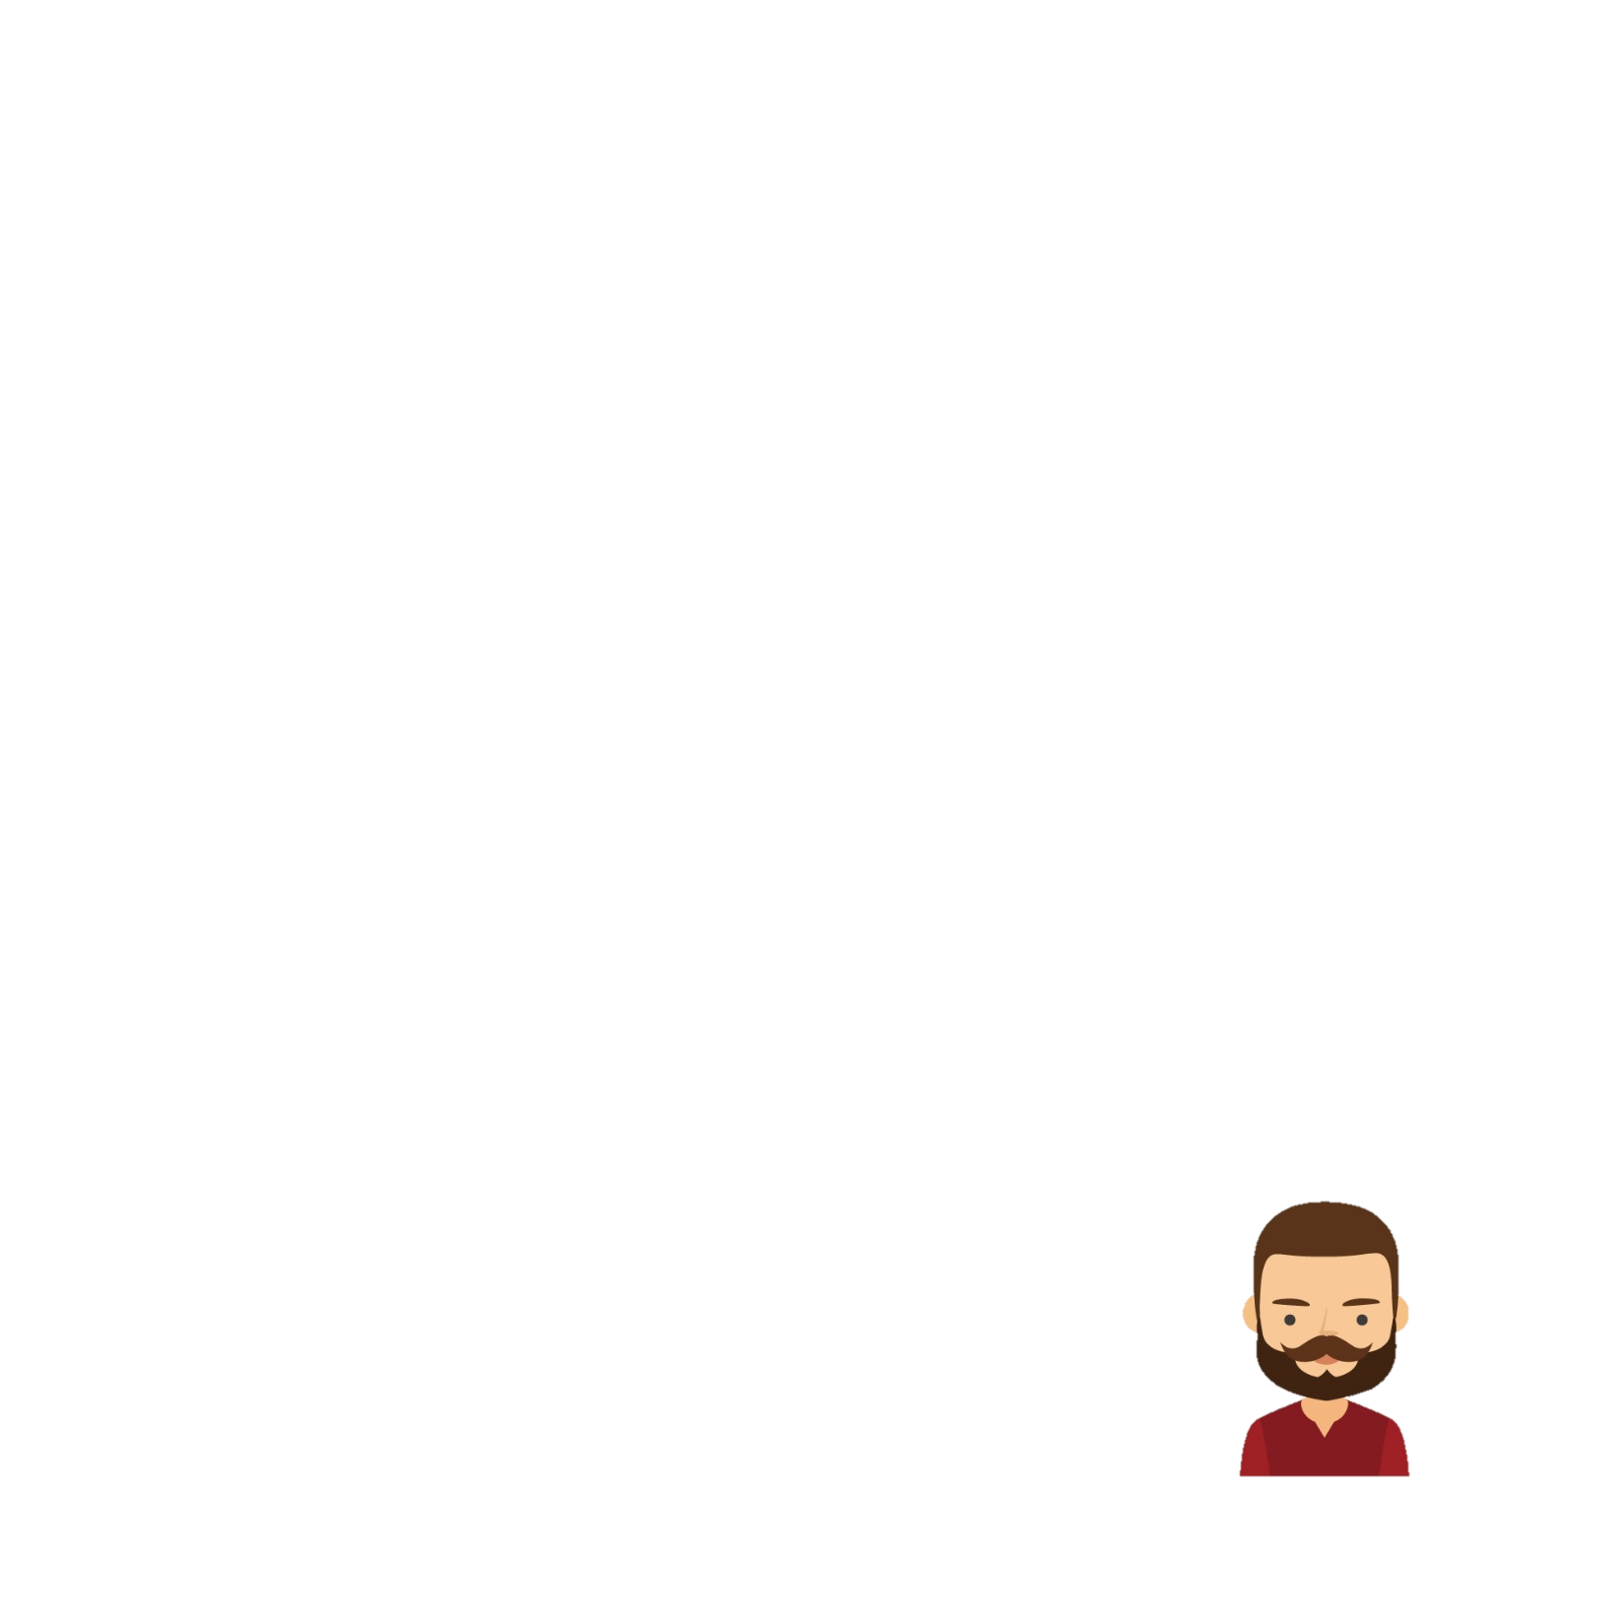

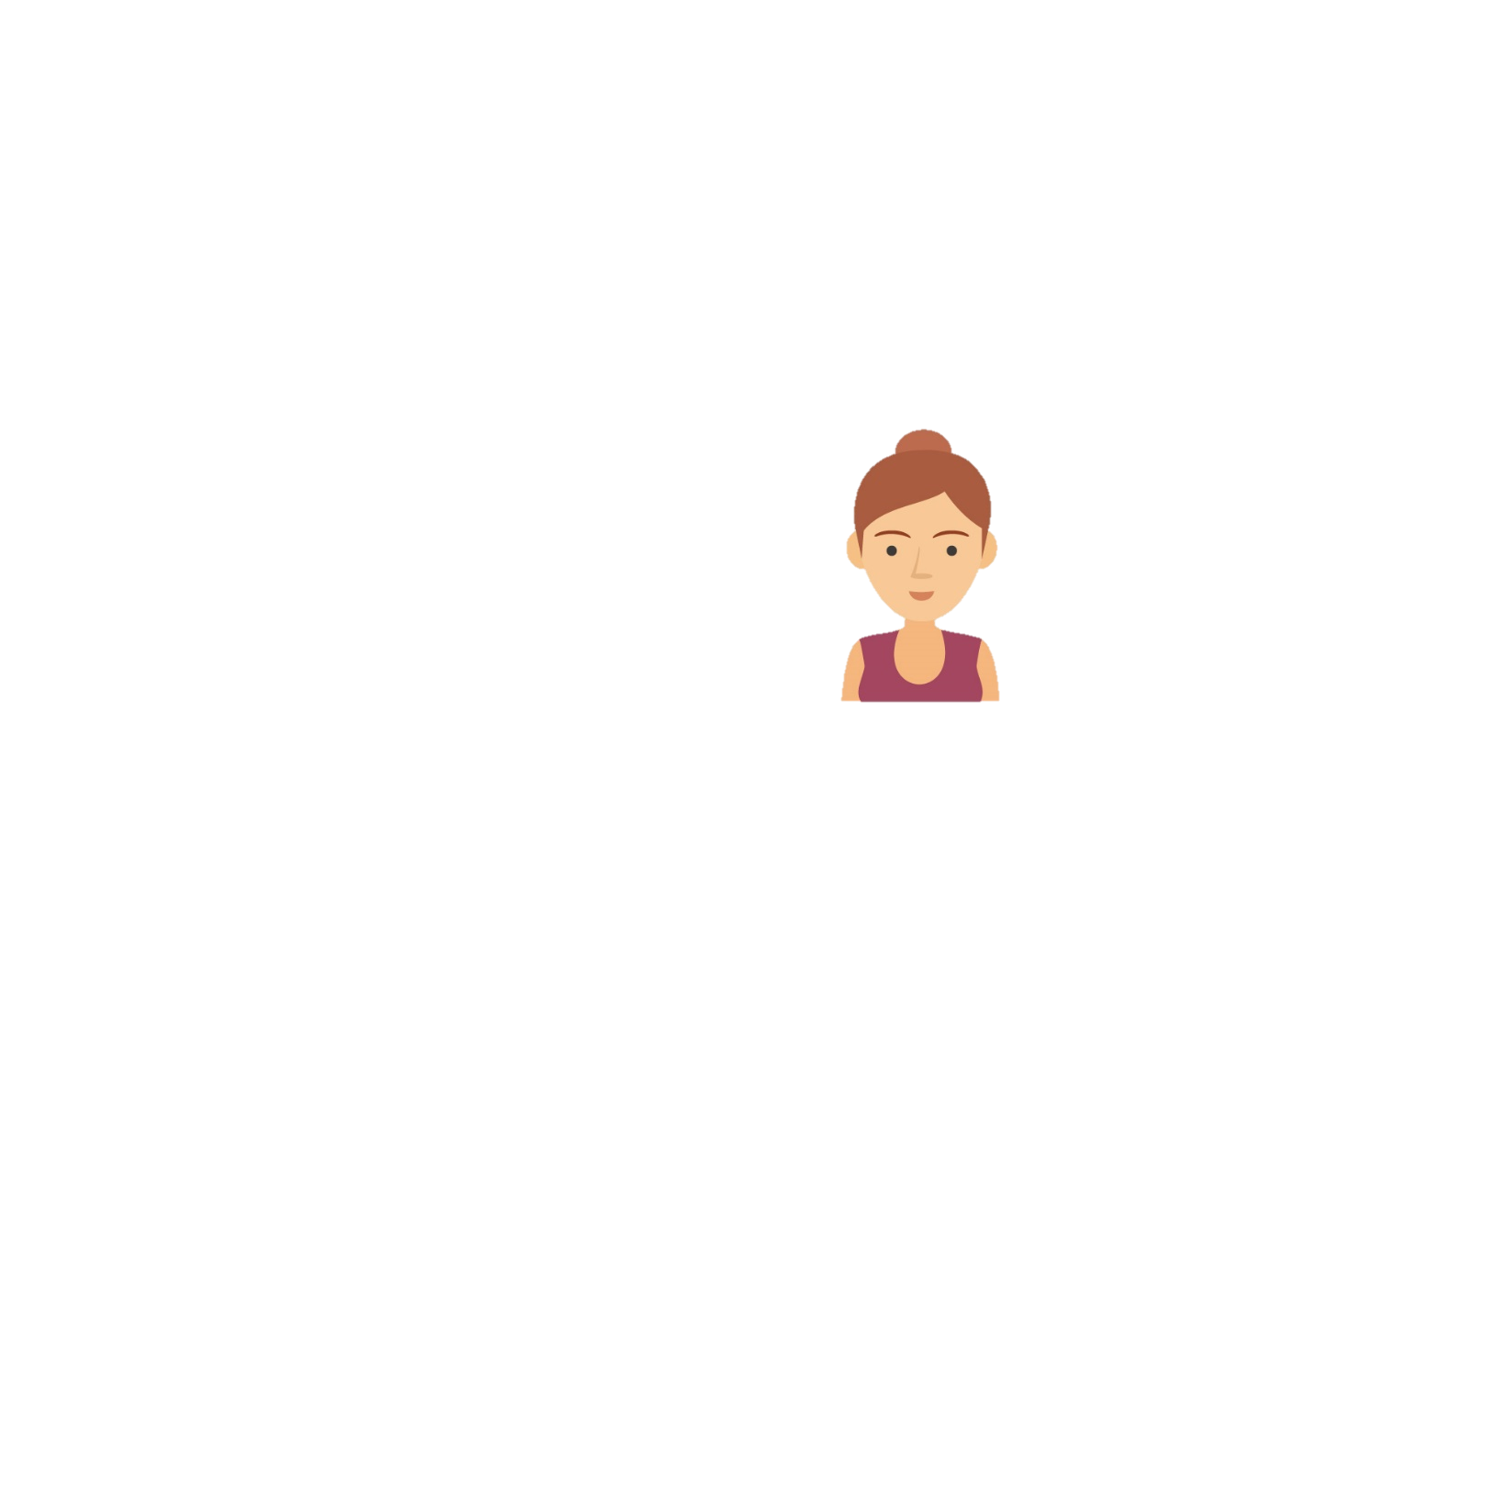

Investing in Solar
3kWh
3kWh
2kWh
1kWh
1kWh

Slide 7


Return on Investment

Slide 8
Socio Economic Impact
New Income source for people
Rajasthan will move towards fully solar based electricity
Reduction of burning of coal
Once we generate enough electricity we can share with neighboring states

Slide 9
Thank You

